Slide 1

Advanced Image Processing
Term Project: Traffic Sign Recognition
Survey and Plan
School of Computer Science
and Engineering
Team5
2022-2

Slide 2
Contents
Team Introduction
Project Survey and Proposal
Plan

Slide 3
Team Introduction
Team5
Pham Thi Thu Hien
2022120203
Ultra-intelligent Computing/Communication Network Lab
Tran Nam Phuong (Leader)
2022120207
Ultra-intelligent Computing/Communication Network Lab
Nguyen Lan Anh
2022220111
Systems and Storage Lab

Slide 4
2. Project Survey and Proposal

Slide 5
2. Project Survey and Proposal

Slide 6
2. Project Survey and Proposal

Slide 7
2. Project Survey and Proposal

Slide 8
2. Project Survey and Proposal

Slide 9
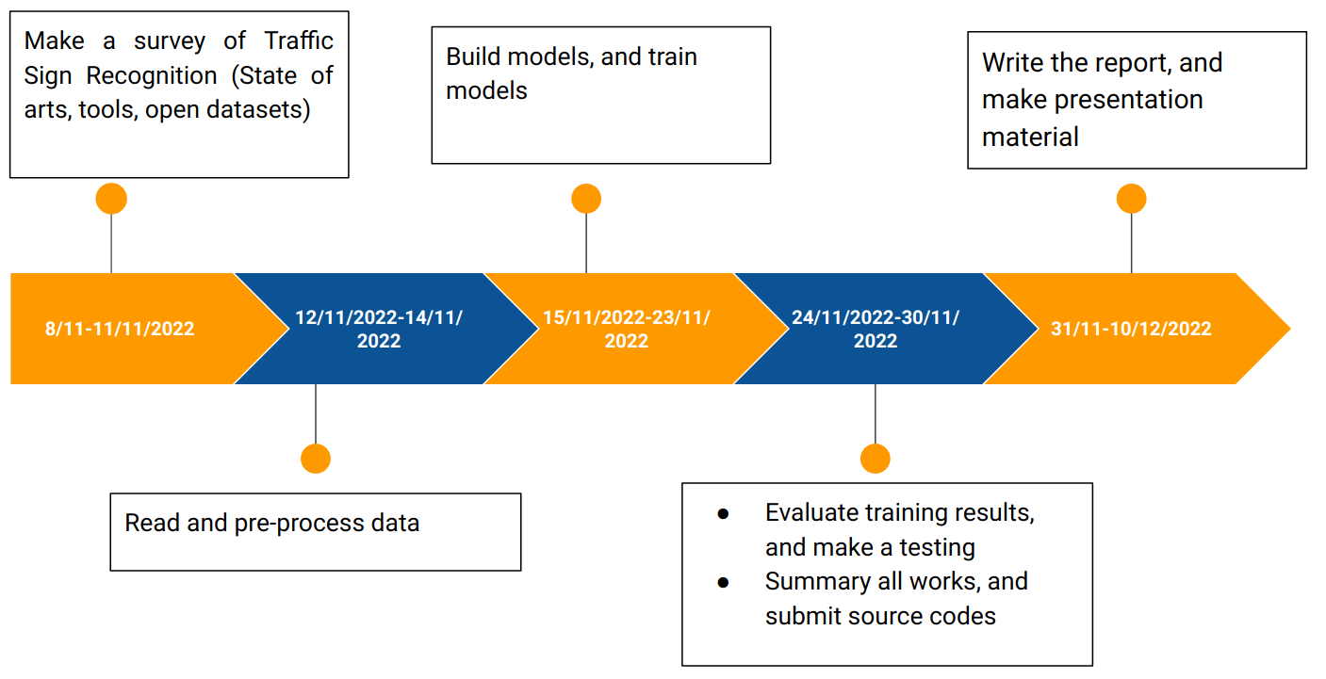
3. Plan

Slide 10
References

